Slide 1
Ready-to-go Lesson Slides
Year 1
Please note: Balance scales and cubes or other non-standard units will be needed for parts of this lesson.
Weight & Volume Lesson 2
Spr4

Slide 3
I know that mass means how heavy something is
I can use cubes or bricks to measure the mass of an object on a scale
Starter:
Jessica is thinking of an object. Her object is heavier than a pencil but lighter than a maths book. What could her object be?

Slide 4
I know that mass means how heavy something is
I can use cubes or bricks to measure the mass of an object on a scale
Starter:
Jessica is thinking of an object. Her object is heavier than a pencil but lighter than a maths book. What could her object be?
Children could use balance scales to investigate objects that fit the criteria.

Slide 5
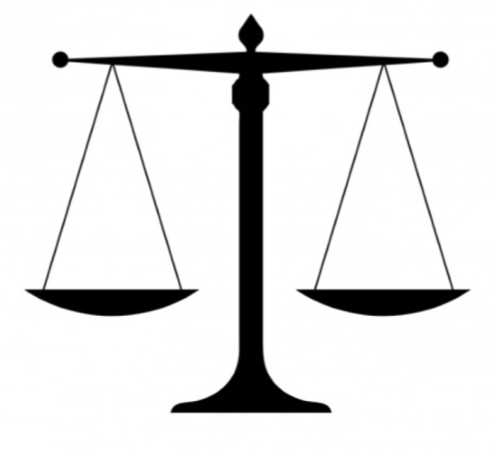
Talking Time:
Look at these objects.
Let’s measure their masses using cubes and a balance scale.
The ______ weighs the same as _____ cubes.

Slide 6
Activity 1:
Use the non-standard units to measure each item on your table.
The ______ weighs the same as _____ cubes.
Extension:
Which is the heaviest item on your table? Which is the lightest?

Slide 7
Talking Time:
Let’s measure these objects using different non-standard units. We could use
Cubes
Pencils
Counters
Other objects

Slide 8
Activity 2:
Weigh an object on your table using cubes and then weigh the object using a different non-standard unit. What did you notice?
Which was good to use?
Which was not good to use?
Extension:
Which non-standard unit was best to measure the weight of your object?

Slide 9
Activity 2:
Weigh an object on your table using cubes and then weigh the object using a different non-standard unit. What did you notice?
Which was good to use?
Which was not good to use?
Children to share what they found out. For a lighter
object, a light unit like counters might be most useful.
For a heavier object, blocks or cubes would be useful.
Extension:
Which non-standard unit was best to measure the weight of your object?

Slide 10
Talking Time:
Which non-standard unit would be best to measure the mass of a pencil?
Counters
Wooden blocks
Cubes

Slide 11
Talking Time:
Which non-standard unit would be best to measure the mass of a pencil?
Counters
Wooden blocks
Cubes
Counters would be best as a pencil is quite a light object.

Slide 12
Talking Time:
Which non-standard unit would be best to measure the mass of a school bag?
Counters
Wooden blocks
Pencils

Slide 13
Talking Time:
Which non-standard unit would be best to measure the mass of a school bag?
Counters
Wooden blocks
Pencils
Wooden blocks would be best as a school bag is quite a heavy object.

Slide 14
Activity 3:
Which non-standard unit would be best to measure the mass of a dictionary?
Counters
Wooden blocks
Cubes
Extension:
Use your chosen unit to see if it works well.

Slide 15
Activity 3:
Which non-standard unit would be best to measure the mass of a dictionary?
Counters
Wooden blocks
Cubes
Dictionaries are quite a heavy book so cubes or
wooden blocks would be most useful.
Extension:
Use your chosen unit to see if it works well.

Slide 16
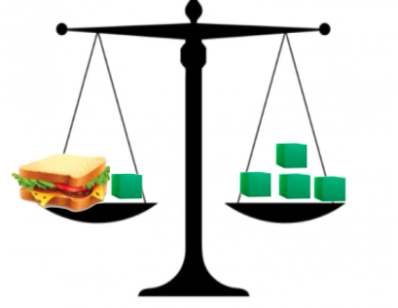
I know that mass means how heavy something is
I can use cubes or bricks to measure the mass of an object on a scale
Evaluation:
How many cubes does the sandwich weigh? How do you know?

Slide 17
I know that mass means how heavy something is
I can use cubes or bricks to measure the mass of an object on a scale
Evaluation:
How many cubes does the sandwich weigh? How do you know?
The sandwich weighs 3 cubes because I can take one cube off each side and it will be balanced.

