Slide 1
Ready-to-go Lesson Slides
Year 1
Please note: Balance scales and various objects will be needed for parts of this lesson.
Weight & Volume Lesson 1
Spr4

Slide 3
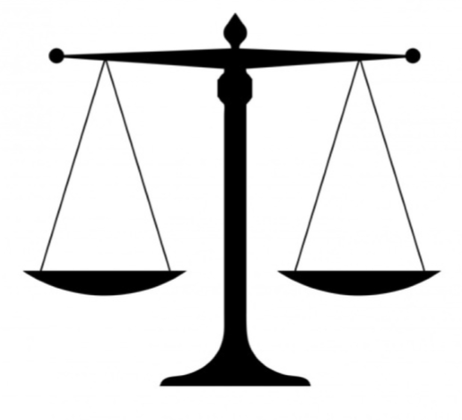
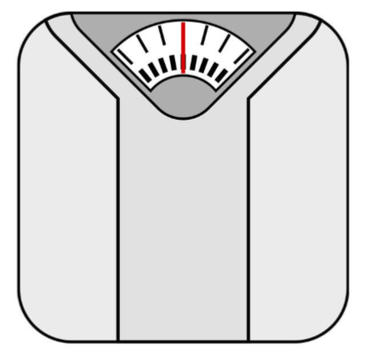
I can say if an object is heavy or light
I can say if one object is heavier or lighter than another and use scales to check
I know that you can't always tell the weight of an object by its size
Starter:
What is different and what is the same about these?

Slide 4
I can say if an object is heavy or light
I can say if one object is heavier or lighter than another and use scales to check
I know that you can't always tell the weight of an object by its size
Starter:
What is different and what is the same about these?
They are both used to measure mass. One is used for comparing the mass of objects and one is used for measuring the weight of a person.

Slide 5
Talking Time:
Look at these two objects.
Which do you think is heavier?
Let’s see on the balance scales.
The _____ is heavier than the _______

Slide 6
Talking Time:
Look at these two objects.
Which do you think is heavier?
Let’s see on the balance scales.
The _____ is heavier than the _______

Slide 7
Activity 1:
Choose two objects. Which is heavier? Which is lighter?
Can you be a human weighing scale?
Now use the weighing scale to check.
Which object is heavier? Which object is lighter?
The ________ is heavier than the _________
Extension:
Can you try two different objects?

Slide 8
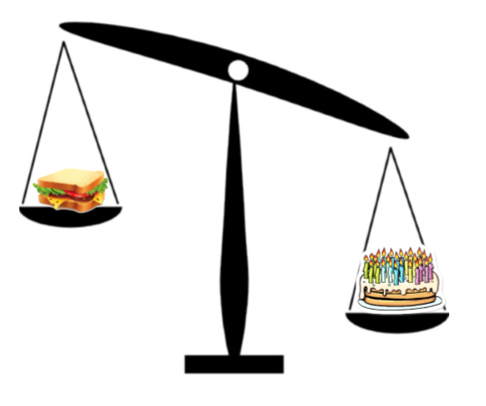
Talking Time:
Look at these balance scales. Fill in the sentence to make them correct.
The _____ is heavier than the ______.

Slide 9
Talking Time:
Look at these balance scales. Fill in the sentence to make them correct.
The cake is heavier than the sandwich.

Slide 10
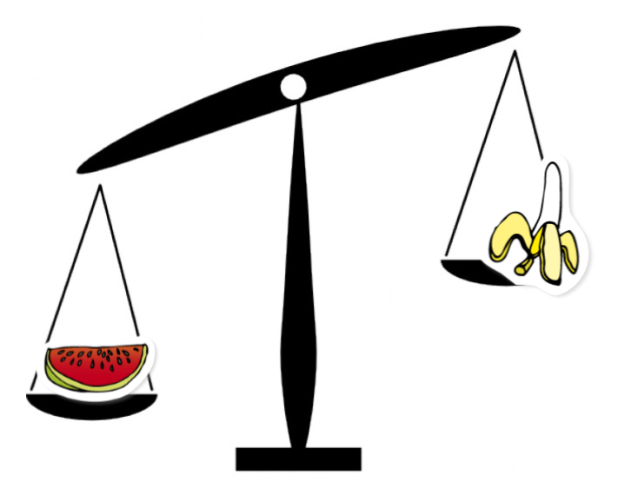
Talking Time:
Look at these balance scales. Fill in the sentence to make them correct.
The _____ is heavier than the ______.

Slide 11
Talking Time:
Look at these balance scales. Fill in the sentence to make them correct.
The melon is heavier than the banana.

Slide 12
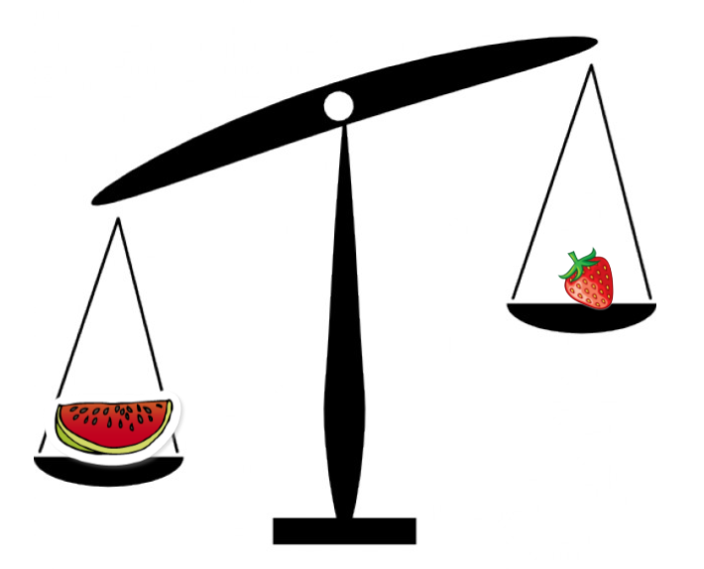
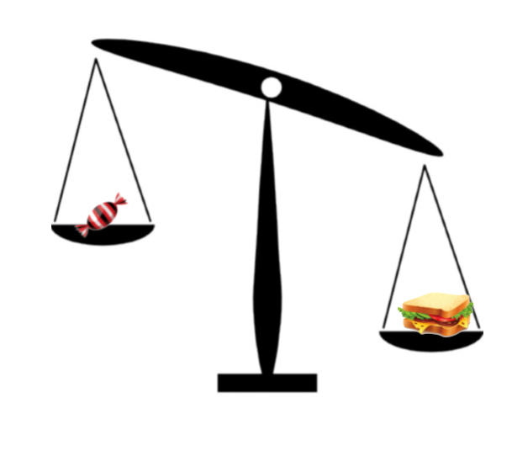
Activity 2:
Look at these balance scales. Fill in the sentence to make them correct.
The _____ is heavier than the ______.
Extension:
What would it look like if the two objects had an equal weight? Draw a picture.
The _____ is heavier than the ______.

Slide 13
Activity 2:
Look at these balance scales. Fill in the sentence to make them correct.
The melon is heavier than the strawberry
Extension:
What would it look like if the two objects had an equal weight? Draw a picture.
The sandwich is heavier than the sweet

Slide 14
Talking Time:
Look at these objects. Which do you think is the heaviest? Let’s use the balance scale to find out.

Slide 15
Activity 3:
Collect different objects from around your classroom. Use a balance scale to find the heaviest object.
Extension:
Can you find two objects that are equal in mass?

Slide 16
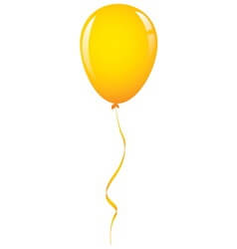
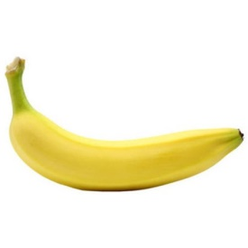
I can say if an object is heavy or light
I can say if one object is heavier or lighter than another and use scales to check
I know that you can't always tell the weight of an object by its size
Evaluation:
The class are seeing whether a balloon or a banana will weigh more.
Paul – “The balloon will be heavier because it is bigger than the banana.”
Mark – “They will both weigh the same because they are both yellow.”
Jane – “The banana will go up because it is lighter.”
Davina – “The balloon will go up because it is lighter.”

Slide 17
I can say if an object is heavy or light
I can say if one object is heavier or lighter than another and use scales to check
I know that you can't always tell the weight of an object by its size
Evaluation:
The class are seeing whether a balloon or a banana will weigh more.
Paul – “The balloon will be heavier because it is bigger than the banana.”
Mark – “They will both weigh the same because they are both yellow.”
Jane – “The banana will go up because it is lighter.”
Davina – “The balloon will go up because it is lighter.”
Davina is correct. However her explanation needs to be clearer. Children should practise using vocabulary such as “heavier than” and “lighter than” when comparing objects. Children should be encouraged to explain why the others are incorrect.

