Slide 1
Ready-to-go Lesson Slides
Year 1
Please note: Various containers are needed to be filled with sand or water for some activities.
Weight & Volume Lesson 6
Spring4

Slide 3
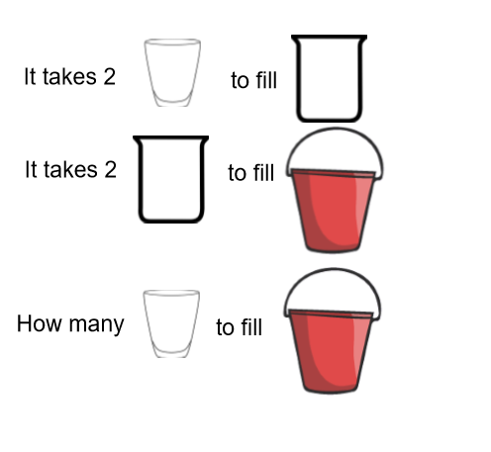
I can compare the capacity of different containers
I know that > < and = mean 'more than', 'less than' and 'equal to'
Starter:

Slide 4
I can compare the capacity of different containers
I know that > < and = mean 'more than', 'less than' and 'equal to'
Starter:
4

Slide 5
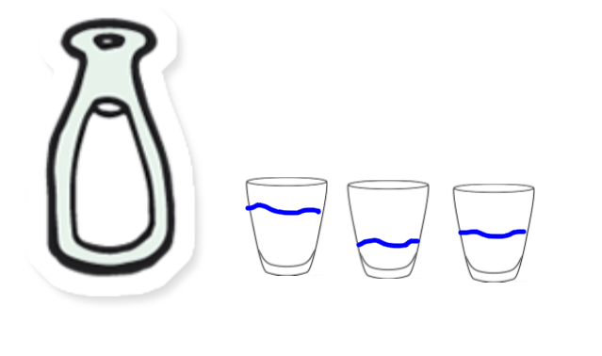
Starter:
Ayesha pours her full container into 3 cups. She says her container has the capacity of 3 cups. Is she correct?

Slide 6
Starter:
Ayesha pours her full container into 3 cups. She says her container has the capacity of 3 cups. Is she correct?
She has not filled
the cups to the top
so her measuring
is inaccurate.

Slide 7
Talking Time:
Look at these 3 containers. Let’s fill each container using the same unit of measure e.g. a small cup.
Let’s order the containers from largest to smallest capacity.

Slide 8
Activity 1:
Take three different containers.
Fill each container with liquid or rice using the same unit of measure e.g. A small cup.
Order the containers from largest to smallest capacity.
Extension:
Can you use the symbols <, > or = to write sentences about your containers?

Slide 9
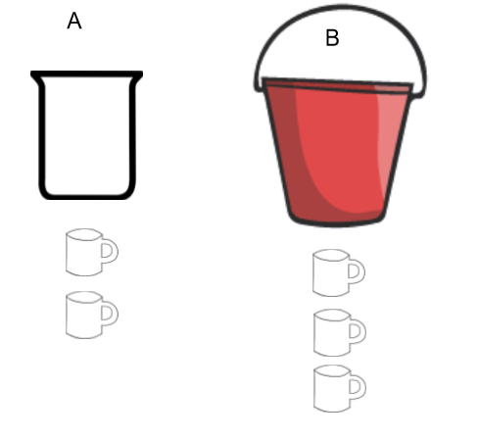
Talking Time:
Look at how many cups fill each container. Use <, > or = to make the statement correct about the capacity.
A ___ B

Slide 10
Talking Time:
Look at how many cups fill each container. Use <, > or = to make the statement correct about the capacity.
A < B

Slide 11
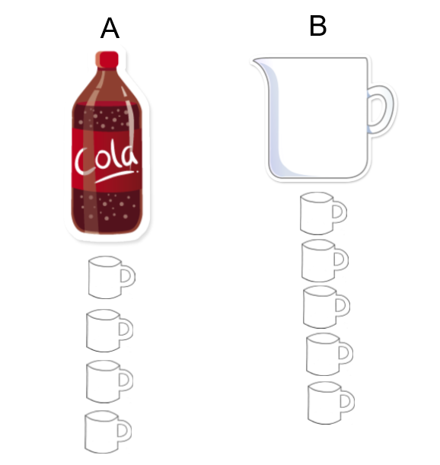
Talking Time:
Look at how many cups fill each container. Use <, > or = to make the statement correct about the capacity.
A __ B

Slide 12
Talking Time:
Look at how many cups fill each container. Use <, > or = to make the statement correct about the capacity.
A < B

Slide 13
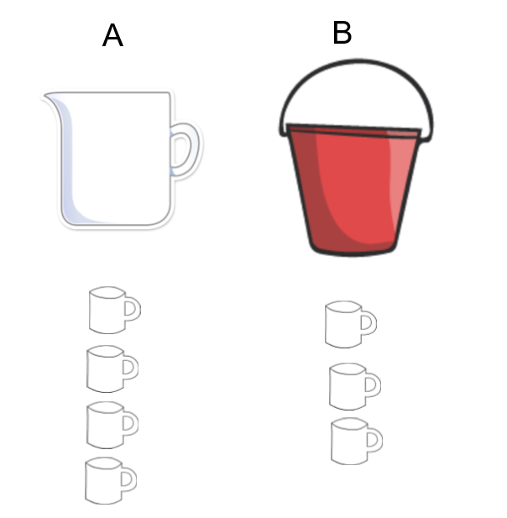
Activity 2:
Look at how many cups fill each container. Use <, > or = to make the statement correct about the capacity.
A __ B
Extension:
Can you draw your own problem like this for a partner?

Slide 14
Activity 2:
Look at how many cups fill each container. Use <, > or = to make the statement correct about the capacity.
A > B
Extension:
Can you draw your own problem like this for a partner?

Slide 15
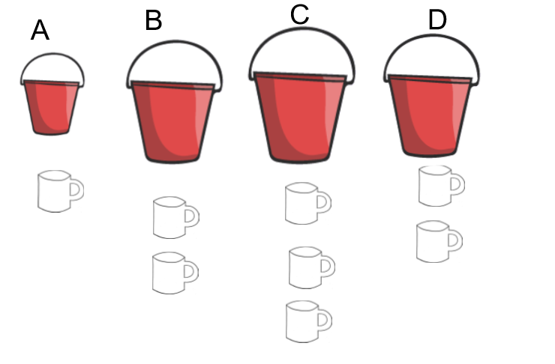
Talking Time:
Complete the statements to compare the capacity of the buckets:
__ > __
__ < __
__ = __

Slide 16
Talking Time:
Complete the statements to compare the capacity of the buckets:
Example answer
B > A
A < C
B = D

Slide 17
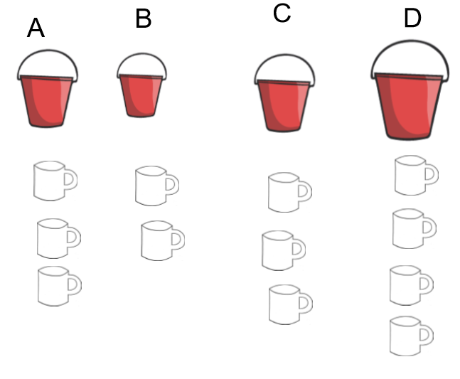
Talking Time:
Complete the statements to compare the capacity of the buckets:
__ > __
__ < __
__ = __

Slide 18
Talking Time:
Complete the statements to compare the capacity of the buckets:
Example answer:
A > B
B < D
C = A

Slide 19
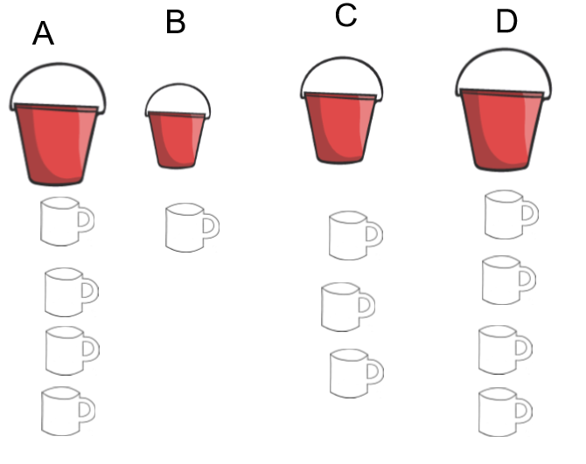
Activity 3:
Complete the statements to compare the capacity of the buckets:
__ > __
__ < __
__ = __
Extension:
Order the buckets from highest capacity to lowest.

Slide 20
Activity 3:
Complete the statements to compare the capacity of the buckets:
Example answer
A > B
B < D
D = A
Extension:
Order the buckets from highest capacity to lowest.

Slide 21
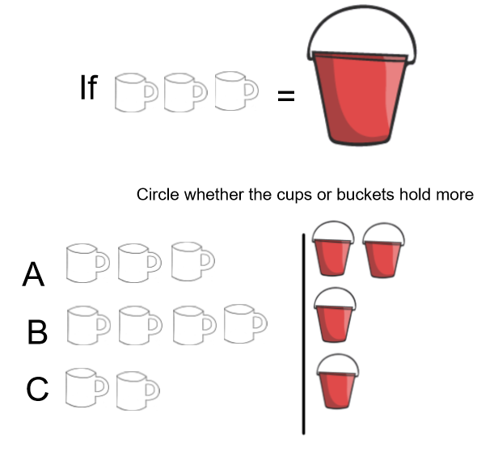
I can compare the capacity of different containers
I know that > < and = mean 'more than', 'less than' and 'equal to'
Evaluation:

Slide 22
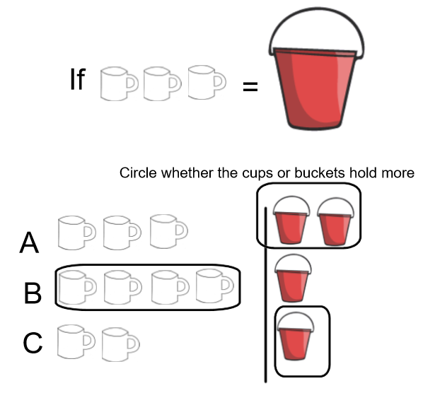
I can compare the capacity of different containers
I know that > < and = mean 'more than', 'less than' and 'equal to'
Evaluation:

