Slide 1
Read Write Inc Phonics
Hello! Let’s get ready to do some super phonics!
Work through the slides to practice previous learning and new sounds and words

Slide 2
Speed Sounds
ea
oi
aw
are
th
er
i-e
oo
ee
qu

Slide 3
Red words
I
we
said
have
Mr
should
the
me
was
do
Mrs
people
into
he
all
some
your
here
to
be
they
come
old
no
my
were
there
by
go
are
like
what
their
little
one
so
could
she

Slide 4
Review oa
goat
boat
loaf

Slide 5
Let’s work on all the new sound ew
ALERT!!
This sound is another one that makes 2 sounds.
It sometimes makes an oo sound, and sometimes makes an you sound.
‘ew – chew the stew’

Slide 6
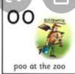
Let’s work on all the oo u-e sounds
'u-e – Huge Brute
Huge
Rude
June
tune
‘oo – poo at the zoo’
Pool
Cool
Stool
moon

Slide 7
Now let’s practice some green words with our new sound ew
Ch ew chew
S t ew stew
B l ew blew
G r ew grew
flew flew

Slide 8
Revise red word – “can’t always Fred a Red!"
would
would
oul – this is the grotty grapheme!
Same grapheme in there – but now makes a different sound! – This makes it Grotty!!

Slide 9
new red word – “can’t always Fred a Red!"
should
should
oul – this is the grotty grapheme!
Same grapheme in there – but now makes a different sound! – This makes it Grotty!!

Slide 10
Let’s practice – can you spot the new red word - were?
would
should
should
my
one
old
be
would
all

Slide 11
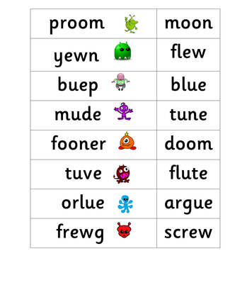
Read the alien and real words.
Can you then get your grown up to choose 3 words at random. Can you then write these using your Fred Fingers?

Slide 12
Hold and write a sentence
What if a huge moon flew away?

