Slide 1
Ready-to-go Lesson Slides
Year 2
Multiplication and division
Lesson 3
Aut2

Slide 3
I know that adding the same number together is the same as equal groups
I know that equal groups can be shown using addition
Starter:
Here is a representation using cubes.
This represents
three equal groups of five.
This represents
five equal groups of three.
Alena
Who is right?
Why?
Aisha

Slide 4
I know that adding the same number together is the same as equal groups
I know that equal groups can be shown using addition
Starter:
Here is a representation using cubes.
This represents
three equal groups of five.
This represents
five equal groups of three.
Alena
Who is right?
Why?
Aisha
Aisha is right.
This is five towers with cubes in each tower.
If Alena was right, there would be three towers with five in each tower.

Slide 5
Talking Time:
Can you use the images to complete the stem sentences?
There are ____ equal groups with ____ in each group.
There are ___ 5s.
____ + ____ = 10.

Slide 6
Talking Time:
Can you use the images to complete the stem sentences?
2
5
There are ____ equal groups with ____ in each group.
There are ___ 5s.
___ + ____ = 10.
two
5
5

Slide 7
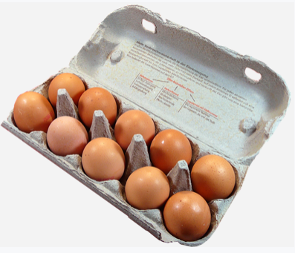
Talking Time:
Can you use the images to complete the stem sentences?
There are ____ equal groups with ____ in each group.
There are ___ 10s.
10 + ____ = ____.

Slide 8
Talking Time:
Can you use the images to complete the stem sentences?
2
10
There are ____ equal groups with ____ in each group.
There are ___ 10s.
10 + ____ = ____.
two
10
20

Slide 9
Talking Time:
Can you use the images to complete the stem sentences?
There are ____ equal groups with ____ in each group.
There are ___ 3s.
____ + ____ = ____.

Slide 10
Talking Time:
Can you use the images to complete the stem sentences?
There are ____ equal groups with ____ in each group.
There are ___ 3s.
____ + ____ = ____.
2
3
two
3
3
6

Slide 11
Activity 1:
Can you draw the images to match these stem sentences?
There are 2 equal groups
with 4 in each group.
There are two 4s.
4 + 4 = 8.

Slide 12
Activity 1:
Can you draw the images to match these stem sentences?
There are 2 equal groups
with 4 in each group.
There are two 4s.
4 + 4 = 8.
Your answer might look something like this.

Slide 13
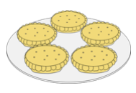
Talking Time:
Can you use the images to complete the stem sentences?
There are ____ equal groups with ____ in each group.
There are three ___s.
____ + ____ + ____ = 15.

Slide 14
Talking Time:
Can you use the images to complete the stem sentences?
3
5
There are ____ equal groups with ____ in each group.
There are three ___s.
____ + ____ + ____ = 15.
5
5
5
5

Slide 15
Talking Time:
Can you use the images to complete the stem sentences?
There are ____ equal groups with ____ in each group.
There are three ___s.
____ + ____ + ____ = 9.

Slide 16
Talking Time:
Can you use the images to complete the stem sentences?
There are ____ equal groups with ____ in each group.
There are three ___s.
____ + ____ + ____ = 9.
3
3
3
3
3
3

Slide 17
Talking Time:
Can you use the chocolate square images to complete the stem sentences?
There are ____ equal groups with ____ in each group.
There are three ___s.
____ + 10 + ____ = ____.

Slide 18
Talking Time:
Can you use the chocolate square images to complete the stem sentences?
There are ____ equal groups with ____ in each group.
There are three ___s.
____ + 10 + ____ = ____.
3
10
10
10
10
30

Slide 19
Activity 2:
Noah is trying to work out if this number sentence is true or false.
10 + 10 = 5 + 5 + 5 + 5
What do you think? Why?
Can you draw an image or use some cubes to help to prove your answer?

Slide 20
Activity 2:
Noah is trying to work out if this number sentence is true or false.
10 + 10 = 5 + 5 + 5 + 5
What do you think? Why?
Can you draw an image or use some cubes to help to prove your answer?
It is true.
10 + 10 = 20. 5 + 5 + 5 + 5 is also 20.

Slide 21
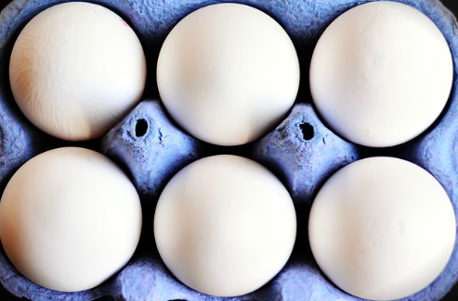
Talking Time:
Here is a table that shows three equal groups with four in each group.
 | Draw it | Say it | Add it
There are
three fours.
4 + 4 + 4 = 12
Can you complete this table for three equal groups with six in each group?
 | Draw it | Say it | Add it

Slide 22
Talking Time:
Here is a table that shows three equal groups with four in each group.
 | Draw it | Say it | Add it
There are
three fours.
4 + 4 + 4 = 12
Can you complete this table for three equal groups with six in each group?
 | Draw it | Say it | Add it
There are
three sixes.
6 + 6 + 6 = 18

Slide 23
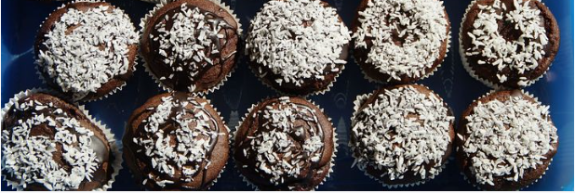
Talking Time:
Can you complete this table for four equal groups with ten in each group?
 | Draw it | Say it | Add it

Slide 24
Talking Time:
Can you complete this table for four equal groups with ten in each group?
 | Draw it | Say it | Add it
There are
four tens.
10 + 10 + 10 + 10
= 40

Slide 25
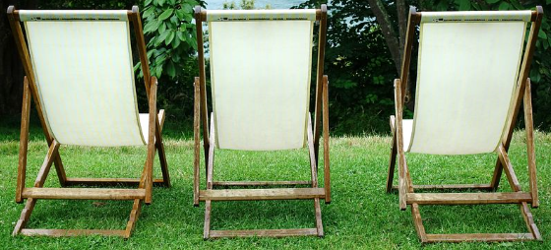
Activity 3:
Does this table represent
three equal groups with seven in each group?
Why? Why not?
 | Draw it | Say it | Add it
There are
three sevens.
3 + 3 + 3 + 3 + 3 + 3 + 3 = 21

Slide 26
Activity 3:
Does this table represent
three equal groups with seven in each group?
Why? Why not?
This is not right.
It is seven equal groups of 3.
 | Draw it | Say it | Add it
There are
three sevens.
3 + 3 + 3 + 3 + 3 + 3 + 3 = 21
This is not right.
It is three equal
groups of 6.
This is correct.
This is not right.
It is seven equal
groups of 3.

Slide 27
I know that adding the same number together is the same as equal groups
I know that equal groups can be shown using addition
Starter:
Odd one out
Which one of these representations does not belong?
Why?
fifteen
5 + 5 + 5
two 10s

Slide 28
I know that adding the same number together is the same as equal groups
I know that equal groups can be shown using addition
Starter:
Odd one out
Which one of these representations does not belong?
Why?
fifteen
This is the odd one out.
Two 10s equals 20.
All the other representations equal 15.
5 + 5 + 5
two 10s

