Slide 1
I can make a total amount of money using different coins and notes
I know that we say pounds (£) first as they are bigger than pence (p)
Starter:
The answer is
£41 and 26p.
Which of these is the question? Why?
£20 + £10 + £10 + £1 + 10p + 10p + 5p + 1p = ?
£10 + £10 + £10 + £10 + £1 + 10p + 10p + 5p + 1p = ?
£20 + £10 + £10 + £1 + 20p + 2p + 2p + 2p = ?

Slide 2
Starter:
The answer is
£41 and 26p.
Which of these is the question? Why?
They all could be. They are all different ways of making £41 and 26p.
£20 + £10 + £10 + £1 + 10p + 10p + 5p + 1p = ?
£10 + £10 + £10 + £10 + £1 + 10p + 10p + 5p + 1p = ?
£20 + £10 + £10 + £1 + 20p + 2p + 2p + 2p = ?

Slide 3
Talking Time:
Lola has emptied her money box.
She needs 58p to buy an apple.
Put a circle around each coin she could use.

Slide 4
Talking Time:
Lola has emptied her money box.
She needs 58p to buy an apple.
Put a circle around each coin she could use.

Slide 5
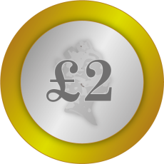
Talking Time:
Jenson has emptied his money box.
He needs £1 and 75p to buy an ice cream.
Put a circle around each coin he could use.
Is there more than one answer?

Slide 6
Talking Time:
Jenson has emptied his money box.
He needs £1 and 75p to buy an ice cream.
Put a circle around each coin he could use.
Is there more than one answer?

Slide 7
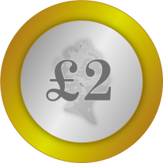
Talking Time:
Bella has emptied her money box.
She needs £6 and 40p to buy her new baby sister a hat.
Put a circle around each coin she could use.
Is there more than one answer?

Slide 8
Talking Time:
Bella has emptied her money box.
She needs £6 and 40p to buy her new baby sister a hat.
Put a circle around each coin she could use.
Is there more than one answer?
Extension:
This is one way of finding the answer, but there are others.
How many other ways can you discover?

Slide 9
Activity 1:
Ava and Ollie have some coins in their pockets.
Is what they are saying true or false?
Can you show how you know?
I have four coins in my pocket.
I have 80p altogether.
Ava
I have three coins in my pocket.
I also have 80p altogether.
Ollie

Slide 10
Activity 1:
Ava and Ollie have some coins in their pockets.
Is what they are saying true or false?
Can you show how you know?
I have four coins in my pocket.
I have 80p altogether.
Ava
I have three coins in my pocket.
I also have 80p altogether.
Ollie
Both are true.
Both children are correct.

Slide 11
Talking Time:
Which of these amounts equals 75p?
Tick the circles that do.

Slide 12
Talking Time:
Which of these amounts equals 75p?
Tick the circles that do.
✓
✓

Slide 13
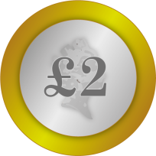
Talking Time:
Which of these amounts does not equal
£1 and 41p?
Tick the circles that do not equal the total.

Slide 14
Talking Time:
Which of these amounts does not equal
£1 and 41p?
Tick the circles that do not equal the total.
✓
✓

Slide 15
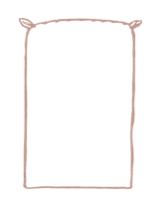
Activity 2:
I have used coins to make these money sacks have a total of 68p.
However, there is an odd one out.
Can you explain your thinking?
20p
20p
20p
2p 2p
2p 2p
50p
5p
5p
5p
3p
50p
5p 5p
2p 2p
1p 1p
1p 1p
50p
10p
5p
2p 1p

Slide 16
Activity 2:
I have used coins to make these money sacks have a total of 68p.
However, there is an odd one out.
Can you explain your thinking?
This money sack is the odd one out.
All the rest are made up of real coins.
There is not a 3p coin.
20p
20p
20p
2p 2p
2p 2p
50p
5p
5p
5p
3p
50p
5p 5p
2p 2p
1p 1p
1p 1p
50p
10p
5p
2p 1p

Slide 17
Talking Time:
Can you draw the money on the money sack to match the label?
£23 and 45p

Slide 18
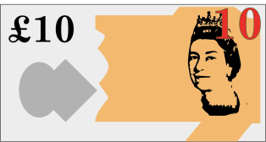
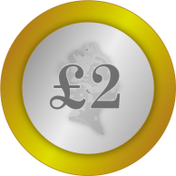
Talking Time:
Extension:
This is one way of finding the answer, but there are others.
How many other ways can you discover?
Can you draw the money on the money sack to match the label?
£23 and 45p

Slide 19
Talking Time:
Can you draw the money on the money sack to match the label?
£19 and 71p

Slide 20
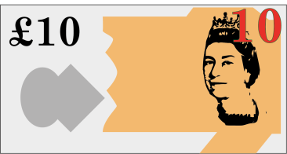
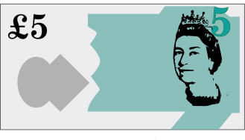
Talking Time:
Extension:
This is one way of finding the answer, but there are others.
How many other ways can you discover?
Can you draw the money on the money sack to match the label?
£19 and 71p

Slide 21
Talking Time:
There is a coin missing from this money sack. Choose the right coin to match the label.
Choose one of these.
£16 and 44p
?

Slide 22
Talking Time:
There is a coin missing from this money sack. Choose the right coin to match the label.
Choose one of these.
✓
£16 and 44p
?
The missing coin is 10p.

Slide 23
Activity 3:
Can you use all the money to fill the money sacks?
You can only use each coin or note once.
£10 and 25p
£5 and 75p

Slide 24
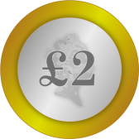
Activity 3:
Can you use all the money to fill the money sacks?
You can only use each coin or note once.
£10 and 25p
£5 and 75p

Slide 25
I can make a total amount of money using different coins and notes
I know that we say pounds (£) first as they are bigger than pence (p)
Evaluation:
Alice has a money box.
Do you agree with what Alice says?
Can you explain why?
I only have silver coins in my money box.
I have 67p altogether.

Slide 26
I can make a total amount of money using different coins and notes
I know that we say pounds (£) first as they are bigger than pence (p)
Evaluation:
Alice has a money box.
Do you agree with what Alice says?
Can you explain why?
I only have silver coins in my money box.
I have 67p altogether.
We cannot agree with Alice because it is impossible
to make 7p with just silver coins.
You would need to use at least one copper coin.

