Slide 1
I can solve word problems about money with two steps to the question
I can show what I know using a bar model
Starter:
Bishan and Evie both had a £1 coin.
They both spent 75p.
Do you agree with the children? Why? Why not?
I received 4 silver coins for my change.
I also received 4 coins for my change, but they were all different to Evie’s.

Slide 2
I can solve word problems about money with two steps to the question
I can show what I know using a bar model
Starter:
Bishan and Evie both had a £1 coin.
They both spent 75p.
Do you agree with the children? Why? Why not?
I received 4 silver coins for my change.
I also received 4 coins for my change, but they were all different to Evie’s.
Evie received a 10p coin and
three 5p coins.
10p + 5p + 5p + 5p = 25p.
Bishan received a 20p coin, two 2p coins and
a 1p coin.
20p + 2p + 2p + 1p = 25p.

Slide 3
Talking Time:
Andy has £57 in the bank.
He puts an extra £40 in there.
Can you complete the bar model and write the calculation to show Andy’s new total?
£__
£__
£40
£___ + £___ = £___

Slide 4
Talking Time:
Andy has £57 in the bank.
He puts an extra £40 in there.
Can you complete the bar model and write the calculation to show Andy’s new total?
£__
£__
£40
£___ + £___ = £___
57
40
97
Andy started with £57. He added on £40 to make £97.
£57 + £10 + £10 + £10 + £10 = £97.

Slide 5
Talking Time:
Andy had £97 in his bank account.
He then spent £26 on a digital radio.
Can you complete the bar model and write the calculation to show Andy’s new total?
£__
£___ - £___ = £___
£26
£__

Slide 6
Talking Time:
Andy had £97 in his bank account.
He then spent £26 on a digital radio.
The calculation could be
worked out using partitioning.
£90 - £20 = £70.
£7 - £6 = £1.
Can you complete the bar model and write the calculation to show Andy’s new total?
£__
97
26
71
£___ - £___ = £___
£26
£__

Slide 7
Talking Time:
Amina had £45 in her bag.
She took out an extra £35 from the cash machine.
Can you complete the bar model and write the calculation to show Amina’s new total?
£__
£__
£35
£___ + £___ = £___

Slide 8
Talking Time:
Amina had £45 in her bag.
She took out an extra £35 from the cash machine.
Can you complete the bar model and write the calculation to show Amina’s new total?
£80
£45
£35
£___ + £___ = £___
45
35
80

Slide 9
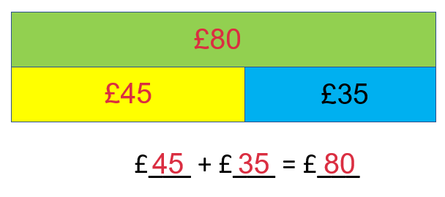
Talking Time:
Amina had £45 in her bag.
She took out an extra £35 from the cash machine.
Can you complete the bar model and write the calculation to show Amina’s new total?
Amina had £80 in her bag. She spent £63 on her weekly shop.
Can you complete the bar model and write the calculation to show Amina’s new total?
£__
£___ - £___ = £___
£63
£__

Slide 10
Talking Time:
Amina had £45 in her bag.
She took out an extra £35 from the cash machine.
Can you complete the bar model and write the calculation to show Amina’s new total?
The calculation could be
worked out by counting on
from £63 to £80.
Amina had £80 in her bag. She spent £63 on her weekly shop.
Can you complete the bar model and write the calculation to show Amina’s new total?
£80
80
63
17
£63
£17
£___ - £___ = £___

Slide 11
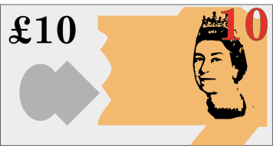
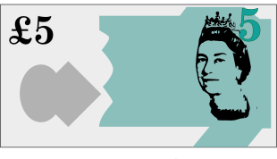
Activity 1:
For her birthday, Alice received some money from her family and friends.
How much money did Alice receive as presents?
If this is the first step of a 2-step problem, can you think of a second step?
Perhaps Alice spent some of her birthday money.

Slide 12
Activity 1:
For her birthday, Alice received some money from her family and friends.
How much money did Alice receive as presents?
Alice received £10 + £10 + £5 + £5 + £5 + £2 + £2 + £1.
This equals £40 altogether.
If this is the first step of a 2-step problem, can you think of a second step?
Perhaps Alice spent some of her birthday money.
What was your second
step?

Slide 13
Talking Time:
Bella has these coins.
How much does she have altogether?
If Bella spent 55p, how much money would she have left?

Slide 14
Talking Time:
Bella has these coins.
How much does she have altogether?
Bella has 50p + 20p + 5p + 5p + 2p + 2p + 2p + 1p.
This equals 50p + 20p + 10p + 6p + 1p = 87p altogether.
If Bella spent 55p, how much money would she have left?
We need to subtract 55p from 87p.
We could partition.
80p – 50p = 30p. 7p – 5p = 2p. 30p and 2p = 32p.

Slide 15
Talking Time:
Ollie has these coins.
How much does he have altogether?
If Ollie spent 49p, how much money would he have left?

Slide 16
Talking Time:
Ollie has these coins.
How much does he have altogether?
Ollie has 20p + 20p + 10p + 10p + 5p + 5p + 2p + 2p.
This equals 40p + 20p + 10p + 4p = 74p altogether.
If Ollie spent 49p, how much money would he have left?
+1p
+20p
+4p
Use the number line and counting on.
1p + 20p + 4p = 25p.
Ollie would have 25p left.
49p
50p
70p
74p

Slide 17
Activity 2:
Darcey has 85p.
She bought an apple for 31p.
Does she have enough money left to buy a pear? Why? Why not?
apple 31p
pear 39p

Slide 18
Activity 2:
Darcey has 85p.
She bought an apple for 31p.
Does she have enough money left to buy a pear? Why? Why not?
apple 31p
pear 39p
Extension:
Can you change the prices on the pieces of fruit and make your own two-step problem like this one?
Darcey had 85p and spent 31p on an apple.
Partition the numbers and subtract.
80p – 30p = 50p. 5p – 1p = 4p. 50p and 4p = 54p.
The pear is only 39p and 54p > 39p, so Darcey does have enough money to buy
an apple and a pear.

Slide 19
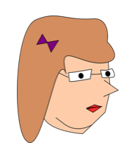
Talking Time:
Mrs Honeyman bought two items.
She bought one hat and one pair of gloves.
How much did she spend?
If she used a £20 note, how much change did she receive?
gloves
£8
hat
£9

Slide 20
Talking Time:
Mrs Harris bought two items.
She bought one hat and one pair of gloves.
How much did she spend?
If she used a £20 note, how much change did she receive?
gloves
£8
hat
£9
Mrs Honeyman spent £9 and £8.
£9 plus £8 = £17.
£20 - £17 = £3.
Mrs Honeyman received £3 in change.
£20
£9
£8
£17
£3

Slide 21
Talking Time:
Andy bought two items.
He bought one t-shirt and one hoody.
How much did he spend?
If he used a £50 note, how much
change did he receive?
hoody
£29
t-shirt
£12

Slide 22
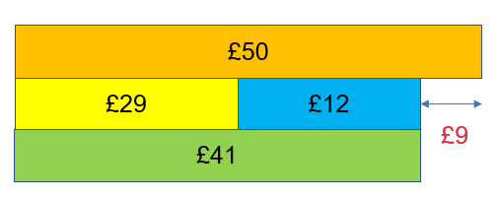
Talking Time:
Andy bought two items.
He bought one t-shirt and one hoody.
How much did he spend?
If he used a £50 note, how much
change did he receive?
hoody
£29
t-shirt
£12
Andy spent £29 and £12.
£29 plus £12 = £29 + £10 + £2 = £41.
£50 - £41 = £9.
Andy received £9 in change.

Slide 23
Activity 2:
Jenson would like to buy a carton of orange juice.
In his right pocket he has three
20p coins.
In his left pocket he has five
5p coins.
Does he enough money to buy the
carton of juice? Why? Why not?
orange juice
89p

Slide 24
Activity 2:
Jenson would like to buy a carton of orange juice.
In his right pocket he has three
20p coins.
In his left pocket he has five
5p coins.
Does he enough money to buy the
carton of juice? Why? Why not?
orange juice
89p
orange juice
89p
No, because he only has 85p. He would need another 4p.
Three 20p coins = 60p.
Five 5p coins = 25p.
60p + 25p = 85p.

Slide 25
I can solve word problems about money with two steps to the question
I can show what I know using a bar model
Evaluation:
Can you spot the mistake in this 2-step problem?
Andy has £25 in his wallet.
He takes out another £55 from the cash machine.
He uses the money for the weekly shop.
The weekly shop will cost £65, so Andy will have £5 left.

Slide 26
I can solve word problems about money with two steps to the question
I can show what I know using a bar model
Evaluation:
Can you spot the mistake in this 2-step problem?
Andy has £25 in his wallet.
He takes out another £55 from the cash machine.
He uses the money for the weekly shop.
The weekly shop will cost £65, so Andy will have £5 left.
This is not right.
If you add £55 and £25 together, you get
£50 + £20 = £70 and £5 + £5 = £10. £70 + £10 = £80.
That is how much Andy has.
£80 - £65 for shopping = £15 and not £5.

