Slide 1
LIFE/work balance
We have started a #LIFEworkbalance campaign and we need your help to complete our LIFE/work balance survey.
We hope to publish the results soon, so please give 15 minutes of your time to help us get a true picture of school life.
Want to be a part of this campaign? Take the survey on our website and share it with your colleagues!
© Classroom Secrets Limited 2020

Slide 2
Year 3 – Spring Block 5 – Fractions – Fractions on a Number Line
About This Resource:
This PowerPoint has been designed to support your teaching of this small step. It includes a starter activity and an example of each question from the Varied Fluency and Reasoning and Problem Solving resources also provided in this pack. You can choose to work through all examples provided or a selection of them depending on the needs of your class.
National Curriculum Objectives:
Mathematics Year 3: (3F1c) Recognise and use fractions as numbers: unit fractions and non-unit fractions with small denominators
More Year 3 Fractions resources.
Did you like this resource? Don’t forget to review it on our website.
© Classroom Secrets Limited 2019

Slide 3
Year 3 – Spring Block 5 – Fractions
Step 6: Fractions on a Number Line
© Classroom Secrets Limited 2019

Slide 4
Introduction
Has Surinder written the fractions on this number line correctly?
0 |  | 10 |  | 20 |  | 30 |  | 40 |  | 50 |  | 60 |  | 70 |  | 80 |  | 90 |  | 1
 |  | 10 |  | 10 |  | 10 |  | 10 |  | 10 |  | 10 |  | 10 |  | 10 |  | 10
© Classroom Secrets Limited 2019

Slide 5
Introduction
Has Surinder written the fractions on this number line correctly?
No he hasn’t. The number line should look like this.
0 |  | 10 |  | 20 |  | 30 |  | 40 |  | 50 |  | 60 |  | 70 |  | 80 |  | 90 |  | 1
 |  | 10 |  | 10 |  | 10 |  | 10 |  | 10 |  | 10 |  | 10 |  | 10 |  | 10
0 |  | 1 |  | 2 |  | 3 |  | 4 |  | 5 |  | 6 |  | 7 |  | 8 |  | 9 |  | 1
 |  | 10 |  | 10 |  | 10 |  | 10 |  | 10 |  | 10 |  | 10 |  | 10 |  | 10
© Classroom Secrets Limited 2019

Slide 6
Varied Fluency 1
What fraction is the arrow pointing to on this number line?
0 |  | 1 |  | 2 |  | 1 | 1 | 1 |  |  |  | 2
 |  | 3 |  | 3 |  |  |  | 3
© Classroom Secrets Limited 2019

Slide 7
Varied Fluency 1
What fraction is the arrow pointing to on this number line?
0 |  | 1 |  | 2 |  | 1 | 1 | 1 | 1 | 2 |  | 2
 |  | 3 |  | 3 |  |  |  | 3 |  | 3
© Classroom Secrets Limited 2019

Slide 8
Varied Fluency 2
Write the fractions in the gaps on the number line.
0 | 1 |  | 2 |  |  |  |  |  | 5 |  | 6 |  | 7 |  |  |  | 9 |  | 1
 | 10 |  | 10 |  |  |  |  |  | 10 |  | 10 |  | 10 |  |  |  | 10
© Classroom Secrets Limited 2019

Slide 9
Varied Fluency 2
Write the fractions in the gaps on the number line.
0 | 1 |  | 2 |  | 3 |  | 4 |  | 5 |  | 6 |  | 7 |  | 8 |  | 9 |  | 1
 | 10 |  | 10 |  | 10 |  | 10 |  | 10 |  | 10 |  | 10 |  | 10 |  | 10
© Classroom Secrets Limited 2019

Slide 10
Varied Fluency 3
Mark on the number line.
1 | 4
 | 6
1 |  |  |  |  |  |  |  |  |  |  |  | 2
© Classroom Secrets Limited 2019

Slide 11
Varied Fluency 3
Mark on the number line.
1 | 4
 | 6
1 |  |  |  |  |  |  | 1 | 4 |  |  |  | 2
 |  |  |  |  |  |  |  | 6
© Classroom Secrets Limited 2019

Slide 12
Varied Fluency 4
True or false? The fractions on this number line are correct.
3 | 2 | 1 | 2 | 2 | 2 | 3 | 2 | 4 | 2 | 5 | 2 | 6 | 2 | 7 |  | 2
 |  | 8 |  | 8 |  | 8 |  | 8 |  | 8 |  | 8 |  | 8
© Classroom Secrets Limited 2019

Slide 13
Varied Fluency 4
True or false? The fractions on this number line are correct.
False; the whole numbers at each end of the number line are in the wrong positions.
3 | 2 | 1 | 2 | 2 | 2 | 3 | 2 | 4 | 2 | 5 | 2 | 6 | 2 | 7 |  | 2
 |  | 8 |  | 8 |  | 8 |  | 8 |  | 8 |  | 8 |  | 8
© Classroom Secrets Limited 2019

Slide 14
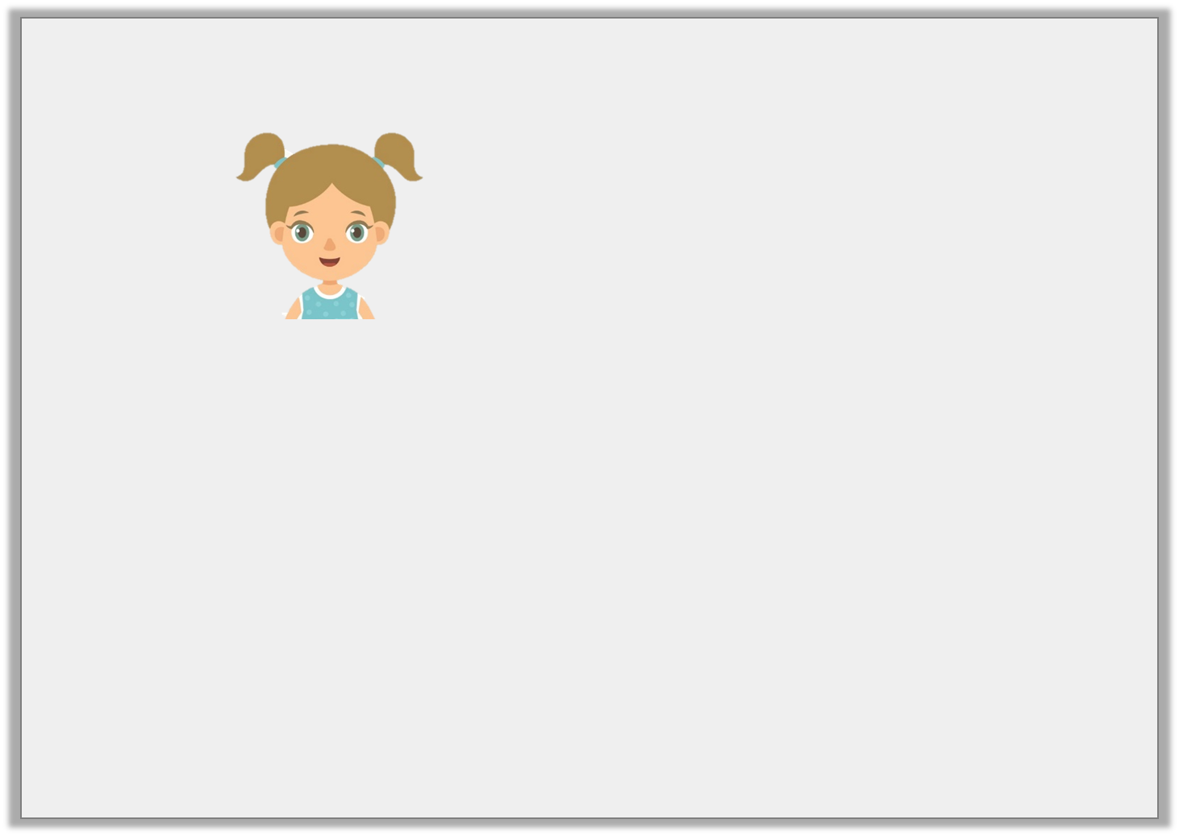
Reasoning 1
Danielle says,
Draw a number line to work out if she is correct. Explain your answer.
2
5
If I start on 1 and count on 7 more fifths, I will end up on 3.
© Classroom Secrets Limited 2019

Slide 15
Reasoning 1
Danielle says,
Draw a number line to work out if she is correct. Explain your answer.
No, Danielle is incorrect because…
2
5
If I start on 1 and count on 7 more fifths, I will end up on 3.
© Classroom Secrets Limited 2019

Slide 16
Reasoning 1
Danielle says,
Draw a number line to work out if she is correct. Explain your answer.
No, Danielle is incorrect because she will land on .
Accept answers which use a number line to show this.
2
5
If I start on 1 and count on 7 more fifths, I will end up on 3.
2 | 4
 | 5
© Classroom Secrets Limited 2019

Slide 17
Problem Solving 1
Aleksander walks to his friend’s house.
He rests when he is of the way there.
At of the way there, he stops at the shop to buy a drink.
Show Aleksander’s journey on the blank number line.
3
7
6
7
Friend’s House
Home
© Classroom Secrets Limited 2019

Slide 18
Problem Solving 1
Aleksander walks to his friend’s house.
He rests when he is of the way there.
At of the way there, he stops at the shop to buy a drink.
Show Aleksander’s journey on the blank number line.
3
7
6
7
Friend’s House
Home
3
7
6
7
© Classroom Secrets Limited 2019

Slide 19
Reasoning 2
Fatima thinks she has labelled this number line correctly.
Is she correct? Explain how you know.
2 | 2 | 1 | 2 | 2 | 2 | 3 | 2 | 4 | 2 | 5 | 2 | 6 | 2 | 7 |  | 2
 |  | 8 |  | 8 |  | 8 |  | 8 |  | 8 |  | 8 |  | 8
© Classroom Secrets Limited 2019

Slide 20
Reasoning 2
Fatima thinks she has labelled this number line correctly.
Is she correct? Explain how you know.
She is incorrect because…
2 | 2 | 1 | 2 | 2 | 2 | 3 | 2 | 4 | 2 | 5 | 2 | 6 | 2 | 7 |  | 2
 |  | 8 |  | 8 |  | 8 |  | 8 |  | 8 |  | 8 |  | 8
© Classroom Secrets Limited 2019

Slide 21
Reasoning 2
Fatima thinks she has labelled this number line correctly.
Is she correct? Explain how you know.
She is incorrect because the whole number at the end of the number line should be 3, not 2.
2 | 2 | 1 | 2 | 2 | 2 | 3 | 2 | 4 | 2 | 5 | 2 | 6 | 2 | 7 |  | 2
 |  | 8 |  | 8 |  | 8 |  | 8 |  | 8 |  | 8 |  | 8
© Classroom Secrets Limited 2019

