Slide 1
Persuasive writing
Week 3 Year 4

Slide 2
This week we are going to look at a letter written by the Wolf from Little Red Riding Hood. Please read through this and make notes on any key words you think have been used to persuade the reader to understand the wolf’s point of view.
I really am rather misunderstood. I’m sure you will see why!

Slide 3
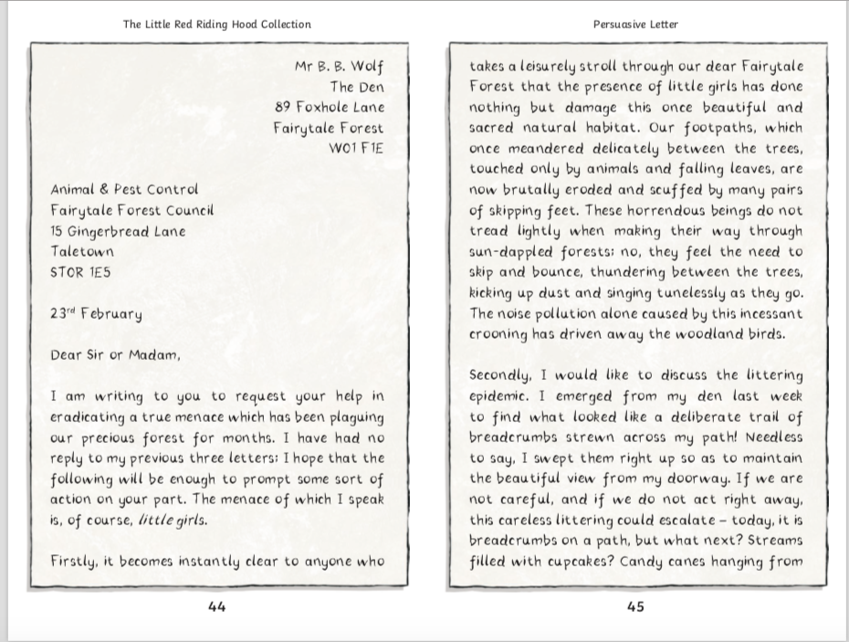

Slide 4
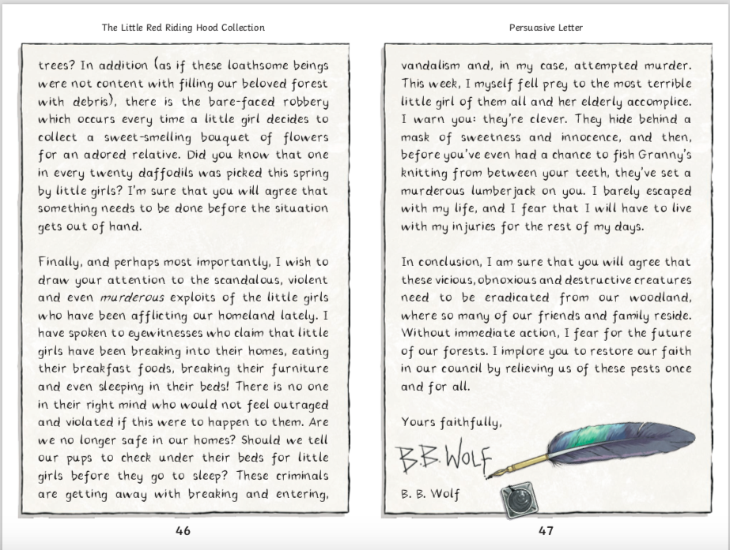

Slide 5
Your task this week is to plan and write a persuasive letter. This can be in a similar style to the wolf’s letter: you could write from the point of view of the bears from Goldilocks, the troll from the Three Billy Goats Gruff, the wolf from the Three Little Pigs, The ugly step sisters in Cinderella etc.
You will need to use persuasive sentence starters. See the word mat on the next slide for examples.
Look at the planning template from the resources pack to know what to include in your writing: introduction, different points in your arguments with evidence etc. Write your letter in your yellow book and focus on the presentation of your writing as well as making sure you are including capital letters, commas and full stops.

Slide 6
