Slide 1
Ready-to-go Lesson Slides
Year 4
Number: Decimals
Tynwlad class

Slide 2
Starter:
Success Criteria: I can use Base 10 and a hundred square to help me understand tenths and hundredths I know that ten hundredths (10/100) equal one tenth (1/10) I can partition a fraction into tenths and hundredths
Which one is different?
?

Slide 3
Starter:
Success Criteria: I can use Base 10 and a hundred square to help me understand tenths and hundredths I know that ten hundredths (10/100) equal one tenth (1/10) I can partition a fraction into tenths and hundredths
Which one is different?
?
A quarter of 68 is the odd one out.
All the other fractions are equal to 18.
However, one quarter of 68 equals 17!

Slide 4
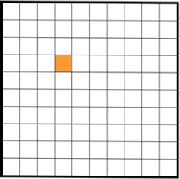
Talking time:
How many squares altogether?
What fraction is shaded?

Slide 5
Talking time:
How many squares altogether?
What fraction is shaded?
This is a hundred square (there are 100 squares altogether).
One of them is shaded, so is shaded.
1 _
100

Slide 6
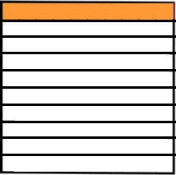
Talking time:
How many rows altogether?
What fraction is shaded?

Slide 7
Talking time:
How many rows altogether?
What fraction is shaded?
There are 10 rows altogether.
One of them is shaded, so is shaded.
1 _
10

Slide 8
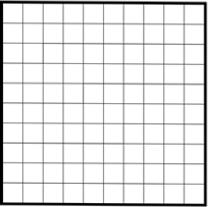
Activity 1:
Complete the missing values.
Each small square is out of equal squares.
So, each square represents of the whole amount.
There are equal rows.
So, each row represents of the whole amount.
? _
?
? _
?

Slide 9
Activity 1:
Complete the missing values.
Each small square is 1 out of 100 equal squares.
So, each square represents of the whole amount.
There are 10 equal rows.
So, each row represents of the whole amount.
1 _
100
1 _
10

Slide 10
Activity 2:
Find five different ways to shade one tenth of this square.
(Use different colours and don’t shade over any square twice!)

Slide 11
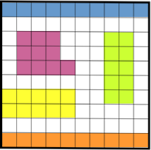
Activity 2:
Find five different ways to shade one tenth of this square.
(Use different colours and don’t shade over any square twice!)
One tenth of 100 is 10 squares because there are ten 10s in 100.
So, as long as you have shaded 10 squares each time, you have shaded one tenth!
The easiest way to see one tenth is as a row (or column).

Slide 12
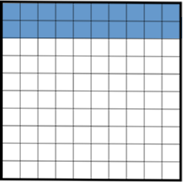
Talking time:
Complete the table.
Number of rows | Tenths | Hundredths

Slide 13
Talking time:
Complete the table.
Number of rows | Tenths | Hundredths
2 | 2 10 | 20 100

Slide 14
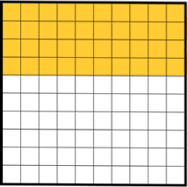
Talking time:
Complete the table.
Number of rows | Tenths | Hundredths

Slide 15
Talking time:
Complete the table.
Number of rows | Tenths | Hundredths
4 | 4 10 | 40 100

Slide 16
Activity 3:
Complete the table.
Number of rows of a hundred square | Tenths | Hundredths
3
5
 | 9 10
 |  | 60 100
 | 8 10

Slide 17
Activity 3:
Complete the table.
Number of rows of a hundred square | Tenths | Hundredths
3 | 3 10 | 30 100
5 | 5 10 | 50 100
9 | 9 10 | 90 100
6 | 6 10 | 60 100
8 | 8 10 | 80 100

Slide 18
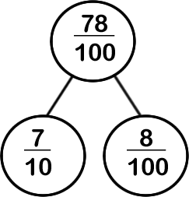
Talking time:
Explain how 78 hundredths has been partitioned here.

Slide 19
Talking time:
Explain how 78 hundredths has been partitioned here.
7 tenths is the same as 70 hundredths, so 78 hundredths can be partitioned into 7 tenths and 8 hundredths.
There are lots of other, less obvious, ways to partition this fraction into tenths and hundredths.
Can you think of another way to do so?

Slide 20
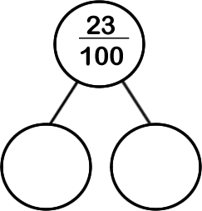
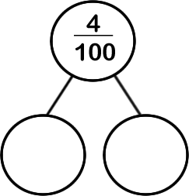
Activity 4:
Sketch part-whole models to partition these fractions into tenths and hundredths.
Try to choose the most obvious way to do so.

Slide 21
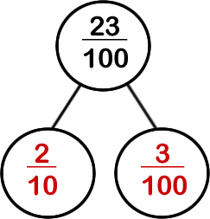
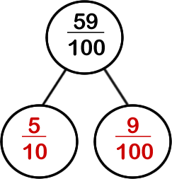
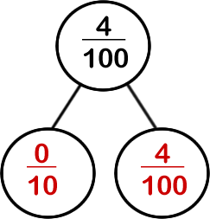
Activity 4:
Sketch part-whole models to partition these fractions into tenths and hundredths.
Try to choose the most obvious way to do so.

Slide 22
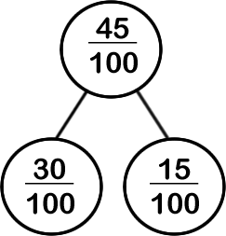
Activity 5:
Here is one way to partition 45 hundredths.
Find as many other different ways to partition this fraction as you can.

Slide 23
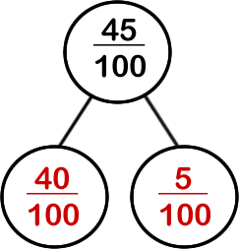
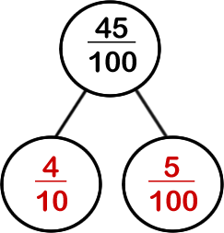
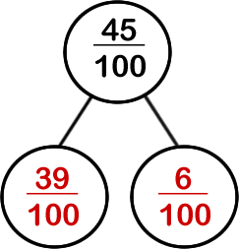
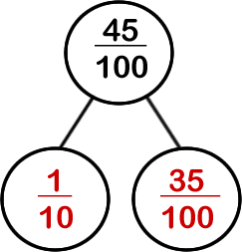
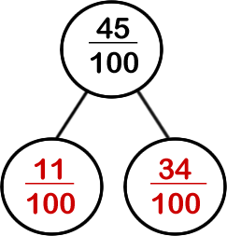
Activity 5:
Here is one way to partition 45 hundredths.
Find as many other different ways to partition this fraction as you can.
For example:

Slide 24
Evaluation:
Success Criteria: I can use Base 10 and a hundred square to help me understand tenths and hundredths I know that ten hundredths (10/100) equal one tenth (1/10) I can partition a fraction into tenths and hundredths
True or False?
One tenth of a hundred square is the same as one complete column of the square.
Ten squares of a hundred square is the same as one hundredths of the square.
=
d) = +
e) Thirty hundredths is less than four tenths.
2
10
20
100
78
100
7
100
8
10

Slide 25
Evaluation:
Success Criteria: I can use Base 10 and a hundred square to help me understand tenths and hundredths I know that ten hundredths (10/100) equal one tenth (1/10) I can partition a fraction into tenths and hundredths
True or False?
One tenth of a hundred square is the same as one
complete column of the square. TRUE
Ten squares of a hundred square is the same as one hundredths of the square. FALSE
= TRUE
d) = + FALSE
e) Thirty hundredths is less than four tenths. TRUE
2
10
20
100
78
100
7
100
8
10

