Slide 1
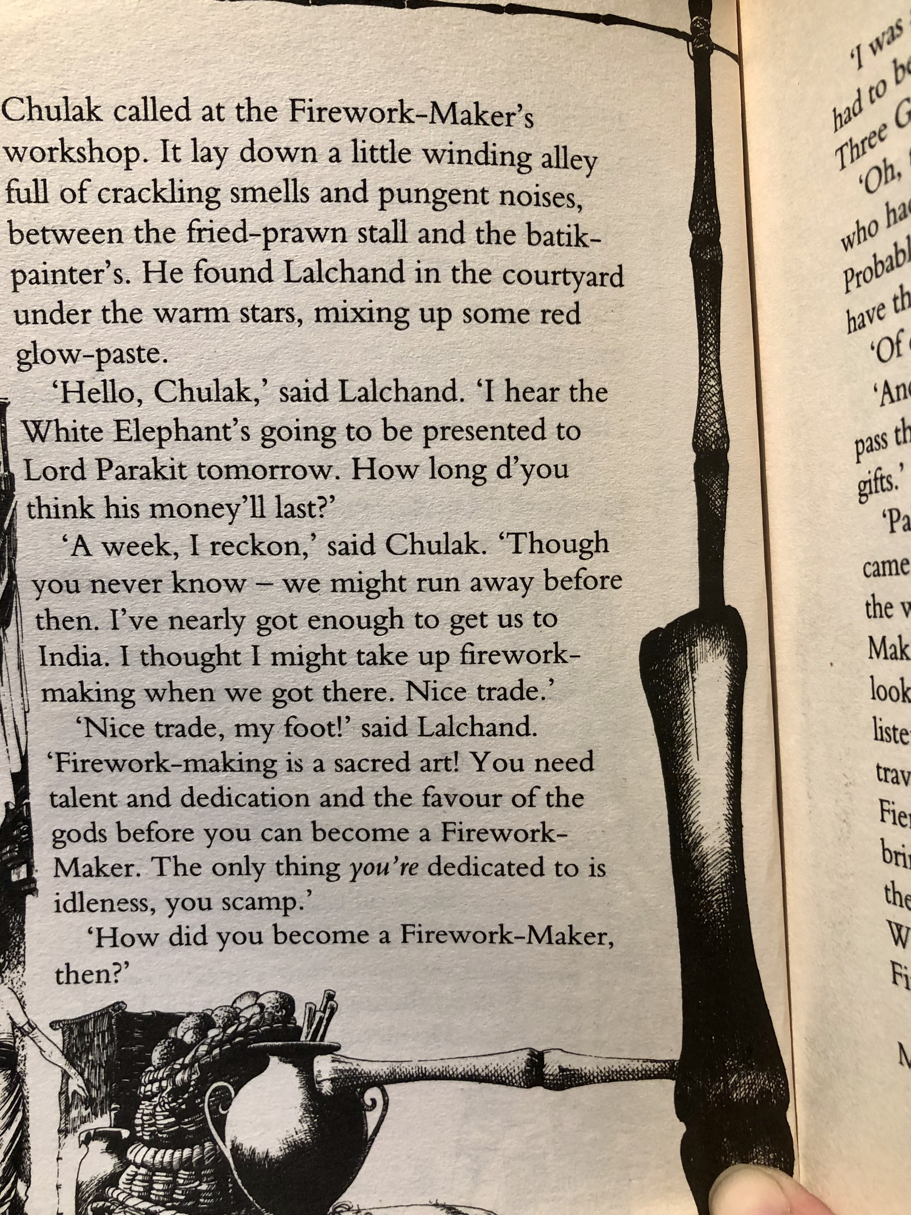
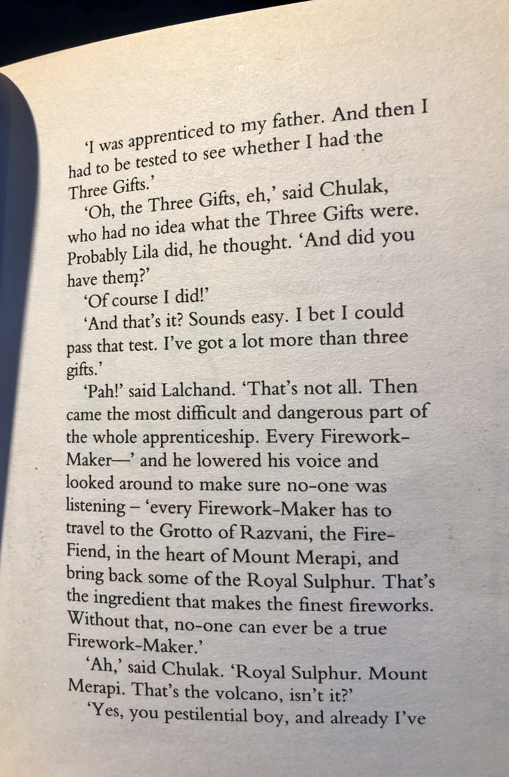

Slide 2
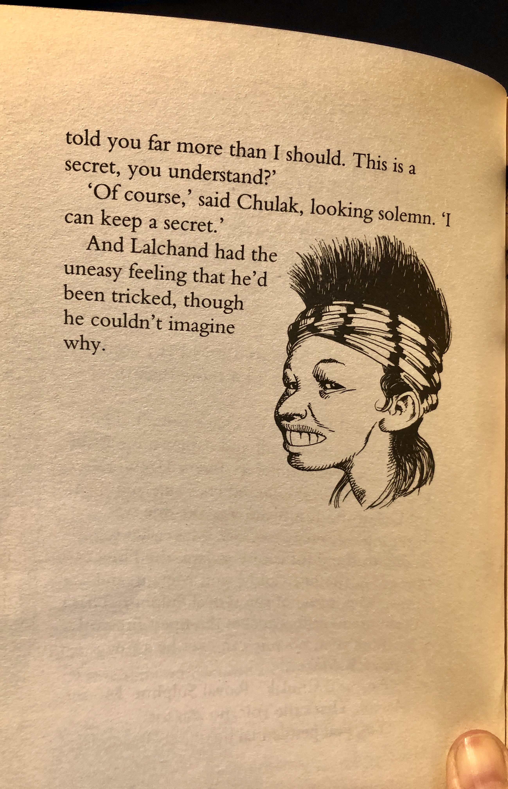
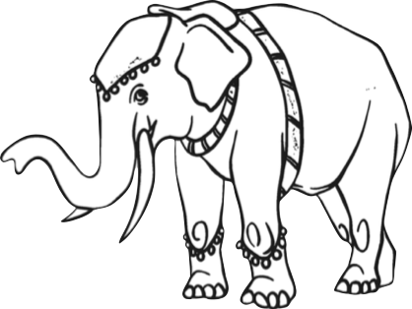

Slide 3
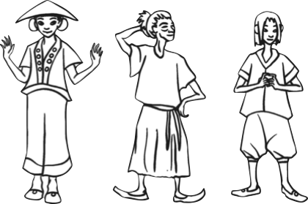
For each question, either talk about it with someone in your family or write the answers down in full sentences.
What horrifies Lila in Chapter 1?
Why do people want to write their names on Hamlet?
What language and word choices does Lalchand use to describe the qualities of a Firework-Maker?
Lalchand says that Chulak is full of ‘idleness’. Do you agree? Explain why or why not.
Who is your favourite character so far and why?
Challenge:
Choose a selection of the most interesting words in this chapter, look them up in a dictionary or online and write down the meaning e.g. Mournfully- full of sorrow.
Choose your favourite character described in this chapter, and use evidence from the story to help you draw a detailed, labelled character sketch.

