Slide 1
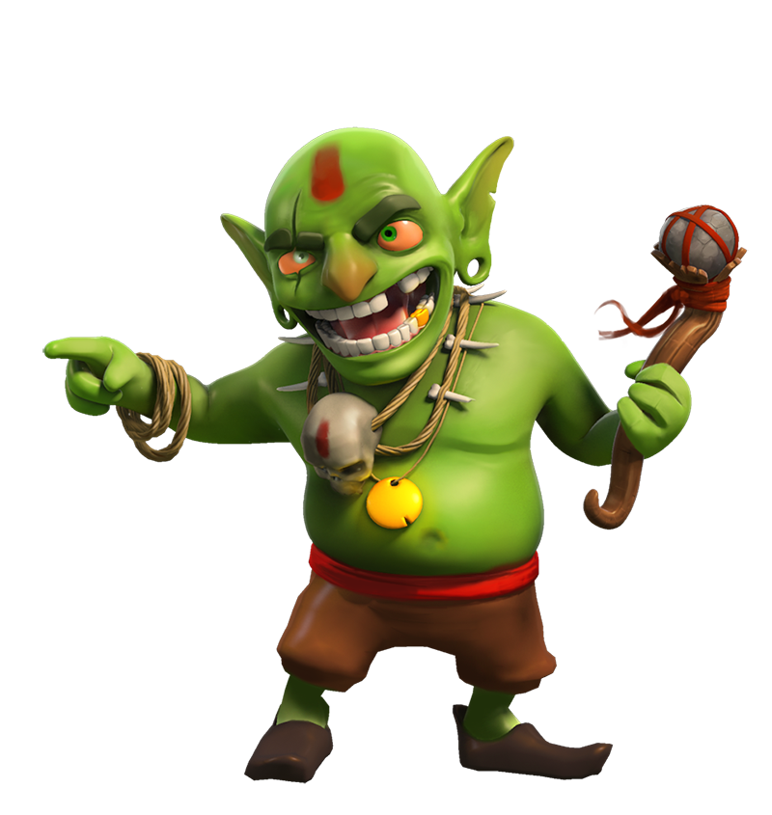
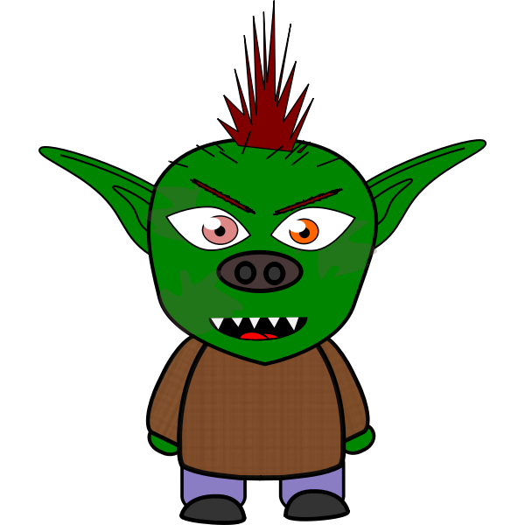
Grizzly Goblins
A GUIDE TO THESE AMAZING BEINGS.

Slide 2
We looked at a model text about aliens last week. We learned about that they are, what they look like, what they eat, where they live, what they do and interesting facts.
This week we are going to look at ways of writing our own information pages.

Slide 3
The first thing we need to do is create our goblin. Let’s look at a link that will help us.
https://www.youtube.com/watch?v=tQ8qPK6FFw0
To aid our writing, we are going to use a variety of descriptive sentences.

Slide 4
Appearance
Choose three things about your goblin to write about.
Begin like this…
Would you know a goblin if you saw one?
An example is…
Most goblins have beady eyes, a bulbous nose and yellow teeth.
1. Remember you need a comma after the first of the three things. Then use and after the second of the three things you are describing.
2. Choose more things to describe about your goblin. Before using a sentence of three, write an adverb generaliser such as
In addition, Additionally, Also, Furthermore.

Slide 5
Habitat.
Describe where your goblin lives.
Use adverbs after your first fact about where they live.
The vast majority of goblins live in dark, damp caves on secluded beaches. Interestingly, The Grizzly Goblin spends their weekends …
Use the following words within your description about where they live.
Interestingly, Surprisingly, Amazingly,
Remember to write a comma after the adverb.
‘Drop in’ sentence
Have a go at dropping in extra information into one of the sentences using a relative clause that starts with ‘who’.
One type of goblin, who are particularly grumpy, live alone under wooden bridges.

Slide 6
What do they eat?
Talk about what goblins like to eat.
Use some of the fronted adverbials to aid your writing.
All goblins are carnivores, additionally, some like to BBQ their meat. surprisingly, their favourite…
Use adding on words such as…
Additionally
Also
Furthermore
Moreover
Engage the reader with adverbs such as
Amazingly,
Intriguingly
Surprisingly
Interestingly
Weirdly

Slide 7
What do they do?
You will now write about what goblins enjoy doing. This might be what they are best known for, things you also didn’t know etc.
Use the adverbial phrases here too.
Goblins are best known for…
Use adding on words such as…
Additionally
Also
Furthermore
Moreover
Engage the reader with adverbs such as
Amazingly,
Intriguingly
Surprisingly
Interestingly
Weirdly

Slide 8
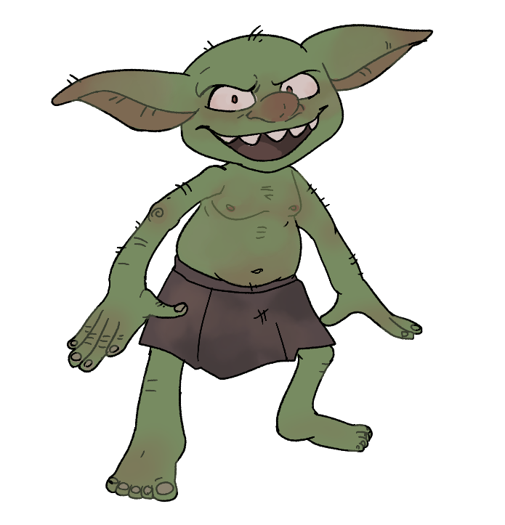
Fascinating facts!
There can be in bullet points.
4 or 5 things that you haven’t already mentioned.
Final paragraph
Finish off your writing by using
Finally, the most amazing thing about goblins is that…

